Slide 1
Progress Report
8-06-2024

Slide 2
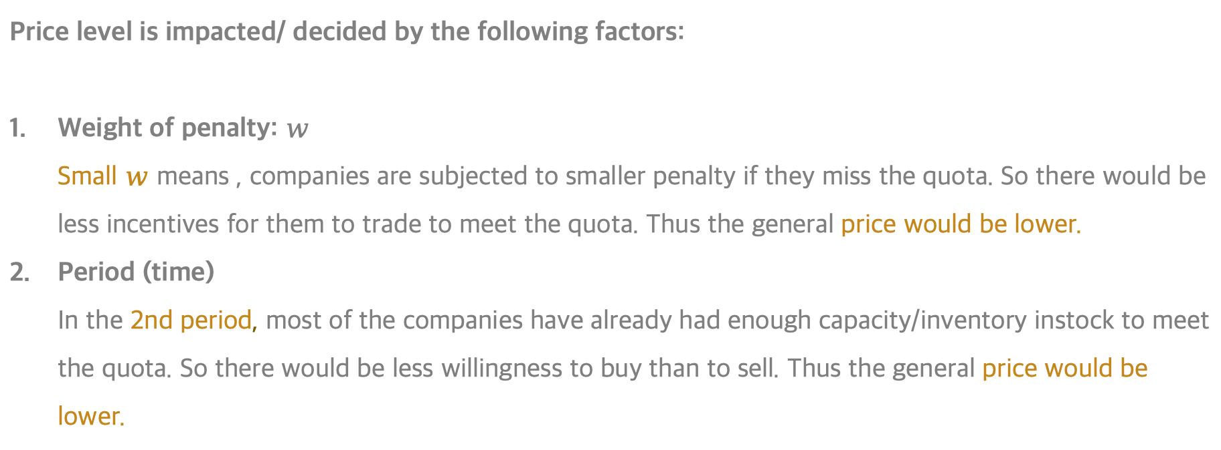
01 - Summary - Price
Price level is impacted/ decided by the following factors:
Weight of penalty: $w$
Small $w$ means , companies are subjected to smaller penalty if they miss the quota. So there would be less incentives for them to trade to meet the quota. Thus the general price would be lower.
Period (time)
In the 2nd period, most of the companies have already had enough capacity/inventory instock to meet the quota. So there would be less willingness to buy than to sell. Thus the general price would be lower.
 | w=1 | w=0.8 | w=0.7 | w=0.5 | w=0.3 | w=0.2
Period 1 | 0.9 | 0.8 | 0.7 | 0.5 | 0.3 | 0.2
Period 2 | 0.8 | 0.7 | 0.6 | 0.4 | 0.2 | 0.1

Slide 3
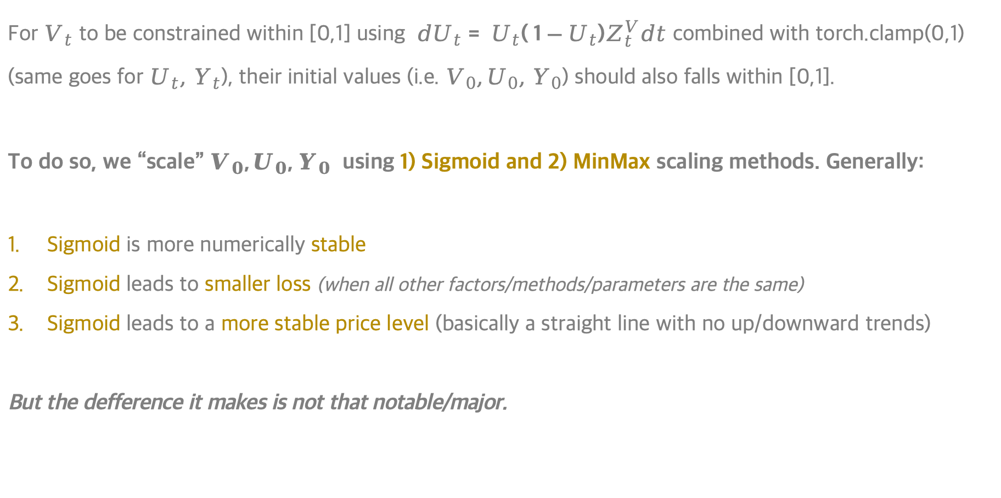
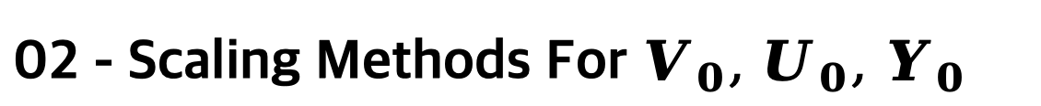
02 - Scaling Methods For $V_{0}, U_{0}, Y_{0}$
For $V_{t}$ to be constrained within [0,1] using ${dU}_{t}= U_{t}( 1−U_{t})Z_{t}^{V}dt$ combined with torch.clamp(0,1) (same goes for$U_{t}, Y_{t}$), their initial values (i.e. $V_{0},U_{0}, Y_{0}$) should also falls within [0,1].
To do so, we “scale” $V_{0},U_{0}, Y_{0}$ using 1) Sigmoid and 2) MinMax scaling methods. Generally:
Sigmoid is more numerically stable
Sigmoid leads to smaller loss (when all other factors/methods/parameters are the same)
Sigmoid leads to a more stable price level (basically a straight line with no up/downward trends)
But the defference it makes is not that notable/major.

Slide 4
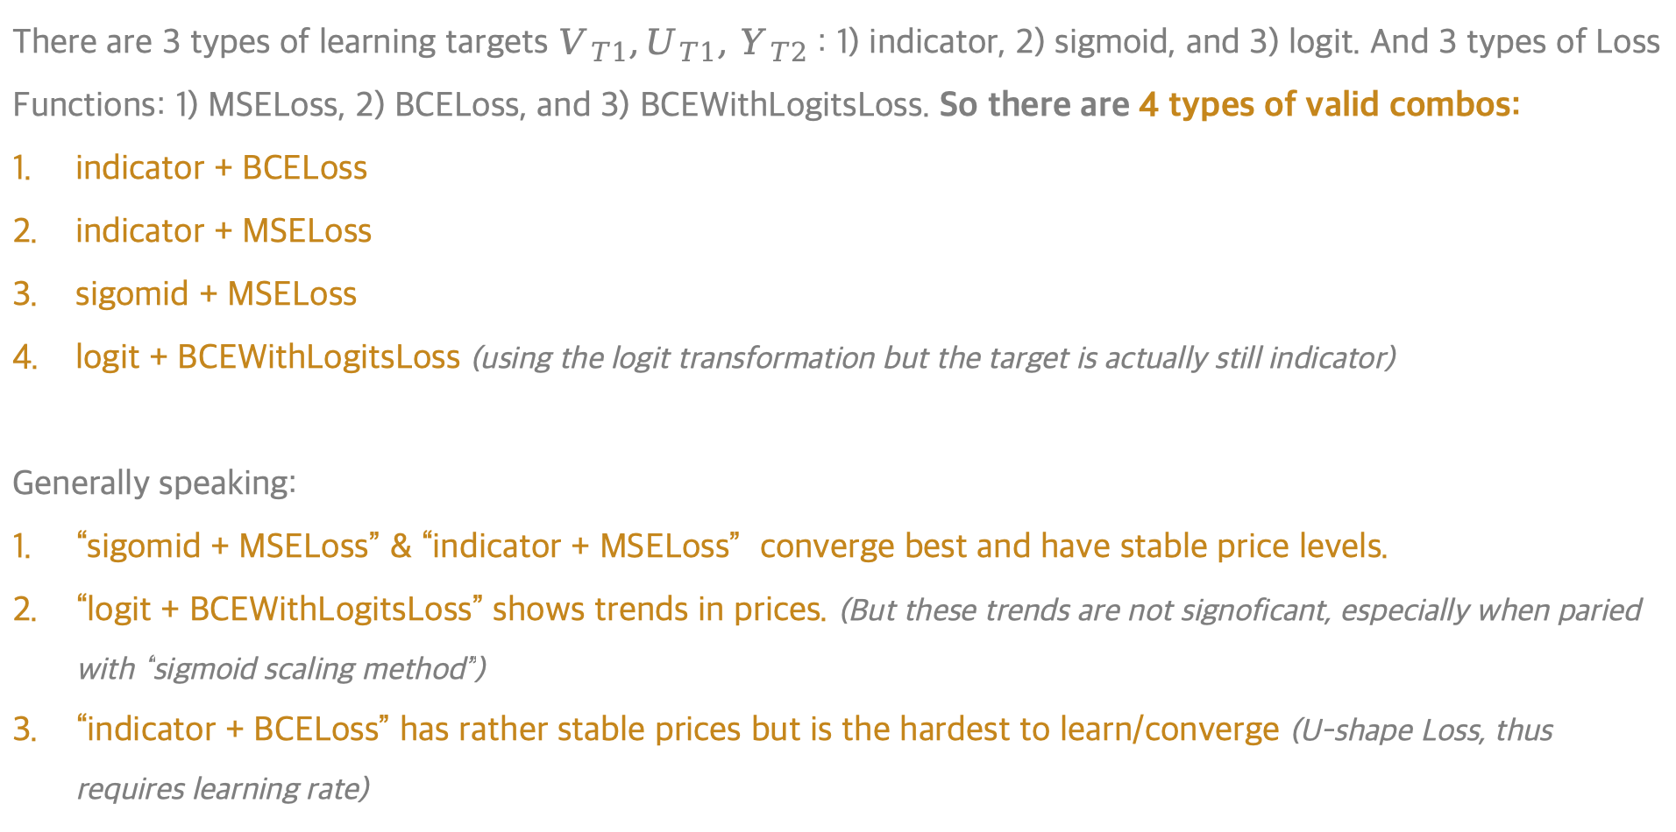
03 - Target & Loss Functions
There are 3 types of learning targets $V_{T1},U_{T1}, Y_{T2}$ : 1) indicator, 2) sigmoid, and 3) logit. And 3 types of Loss Functions: 1) MSELoss, 2) BCELoss, and 3) BCEWithLogitsLoss. So there are 4 types of valid combos:
indicator + BCELoss
indicator + MSELoss
sigomid + MSELoss
logit + BCEWithLogitsLoss (using the logit transformation but the target is actually still indicator)
Generally speaking:
“sigomid + MSELoss” & “indicator + MSELoss” converge best and have stable price levels.
“logit + BCEWithLogitsLoss” shows trends in prices. (But these trends are not signoficant, especially when paried with “sigmoid scaling method”)
“indicator + BCELoss” has rather stable prices but is the hardest to learn/converge (U-shape Loss, thus requires learning rate)

Slide 5
04 - Learning Rate
For “indicator + BCELoss”, which is the hardest to learn/converge, a small learning rate is required. E.g.
When lr=0.0001, converges well.
When lr=0.001, converges badly, i.e. U-shape loss curve.
For other 3 combos, lr=0.001 is sufficiently small. (Yet lr=0.01 would make it harder to converge in some cases)

